Slide 1
Stacked LSTM
DILAB 1901611 조준영
2023.07.20

Slide 2
목 차
Why Increase Depth?
Stacked LSTM Architecture
Implement Stacked LSTMs in Keras

Slide 3
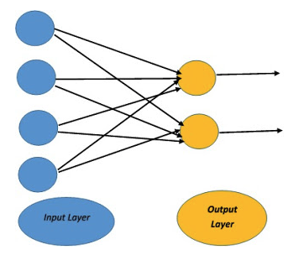
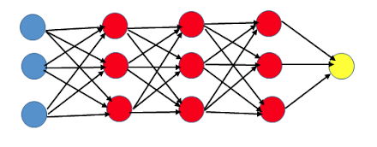
1. Why Increase Depth
A sufficiently large single hidden layer Multilayer Perceptron can be used to approximate most functions. Increasing the depth of the network provides an alternate solution that requires fewer neurons and trains faster. Ultimately, adding depth it is a type of representational optimization.
large single hidden
Increasing the Depth

Slide 4
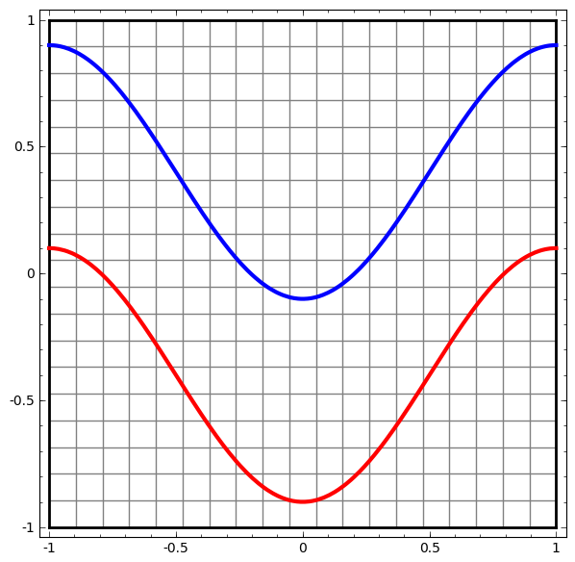
1. Why Increase Depth

Slide 5
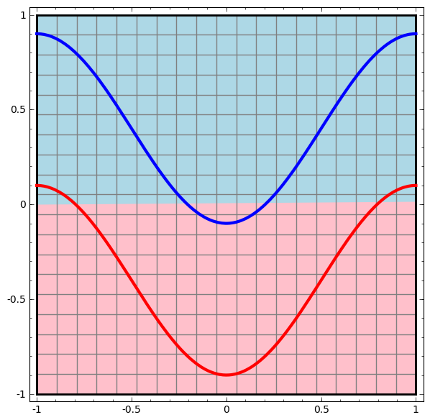
1. Why Increase Depth
With only an input layer and an output layer

Slide 6
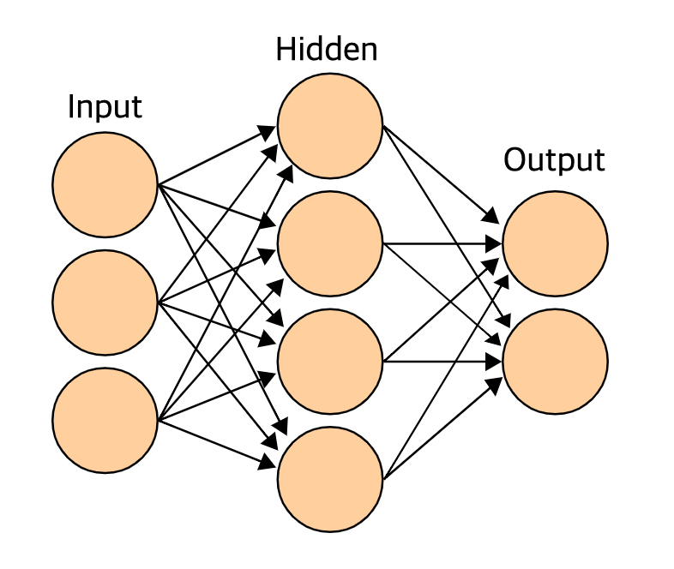
1. Why Increase Depth
simple network with hidden layer

Slide 7
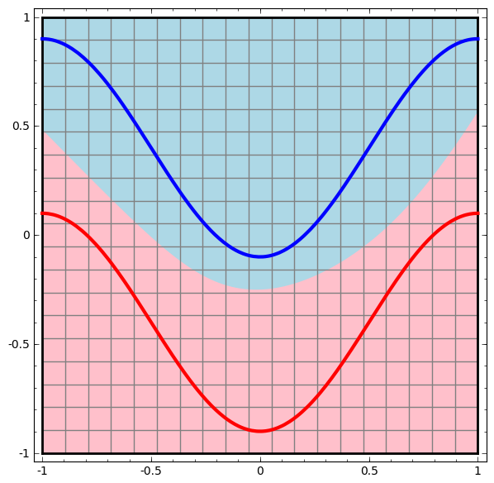
1. Why Increase Depth
simple network with hidden layer

Slide 8
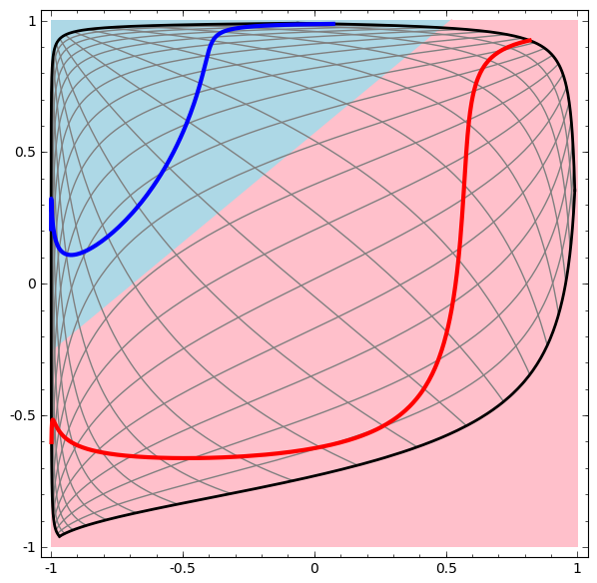
1. Why Increase Depth
The hidden layer learns a representation so that the data is linearly separable
(new representation after transformed by hidden layer)

Slide 9
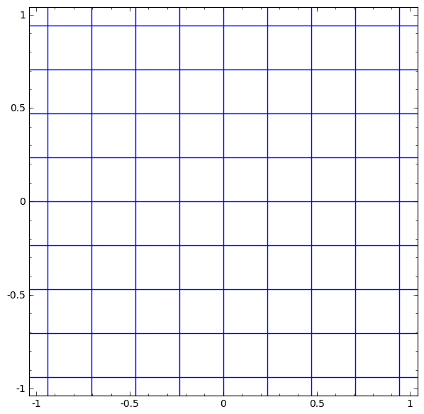
1. Why Increase Depth
continuous linear transformation
(in tanh)

Slide 10
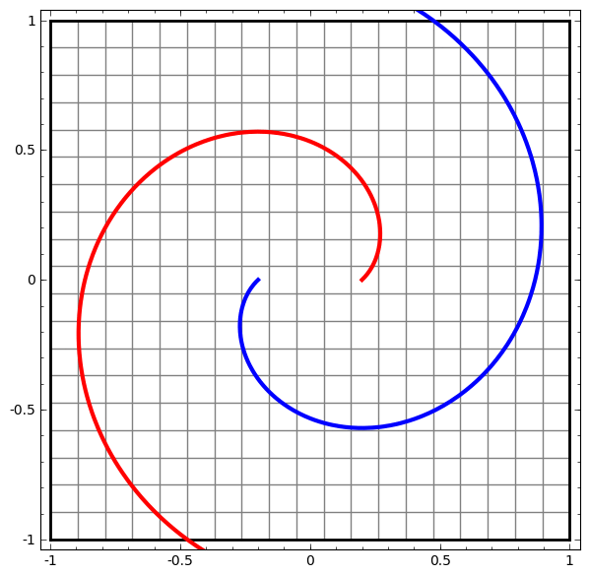
1. Why Increase Depth
simple spirals
separate linearly by shifting from raw representation to high level
(with linear transformation)

Slide 11
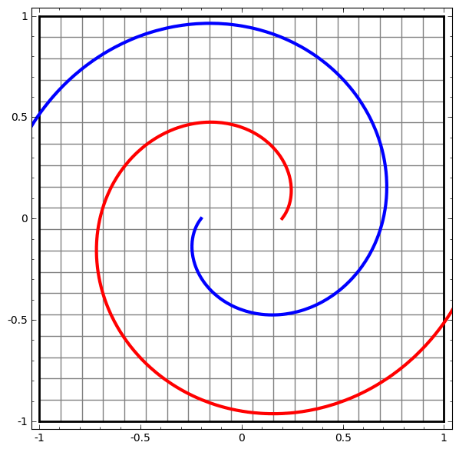
1. Why Increase Depth
entangled spirals
separate linearly by shifting from raw representation to high level
(with linear transformation)

Slide 12
1. Why Increase Depth
entangled spirals
Each layer stretches and squishes space, but it never cuts, breaks, or folds it. Intuitively, we can see that it preserves topological properties. For example, a set will be connected afterwards if it was before (and vice versa).

Slide 13
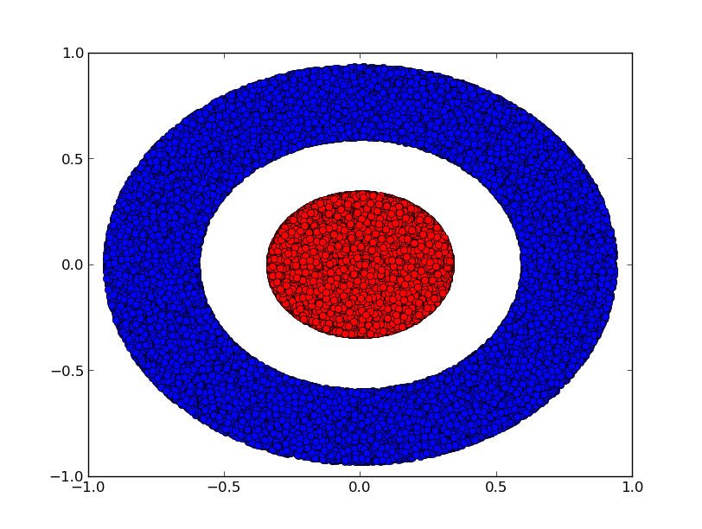
1. Why Increase Depth
continuous linear transformation
(in tanh)

Slide 14
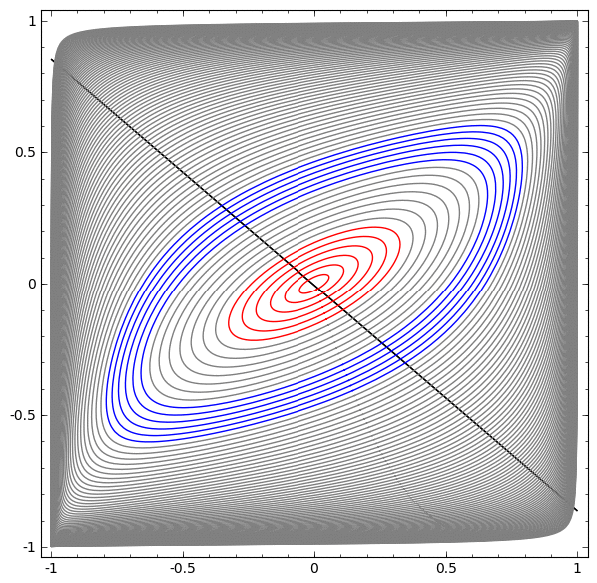
1. Why Increase Depth
only one hidden layer

Slide 15
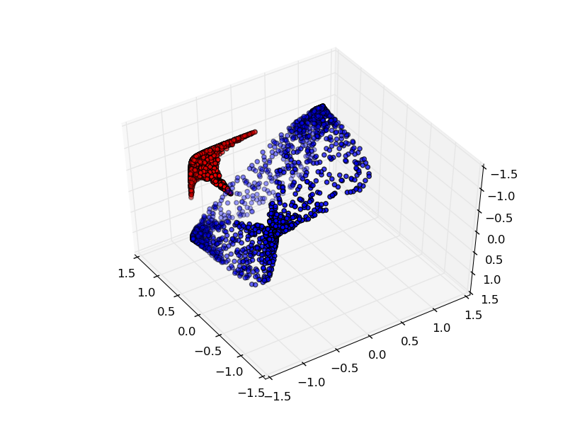
1. Why Increase Depth
Add hidden layer

Slide 16
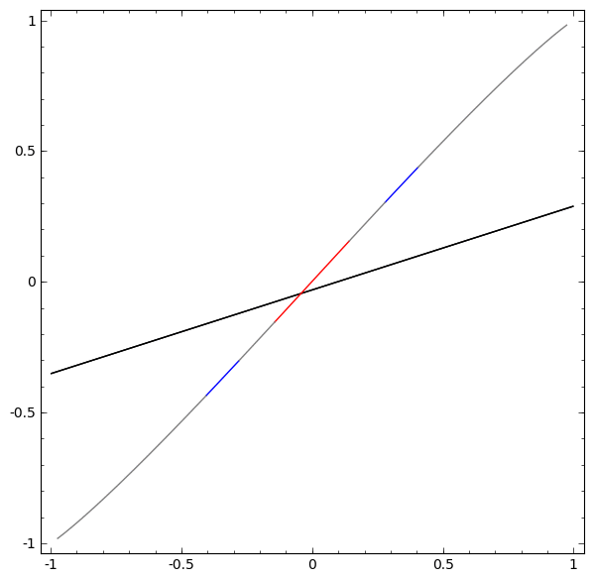
1. Why Increase Depth
Add hidden layer

Slide 17
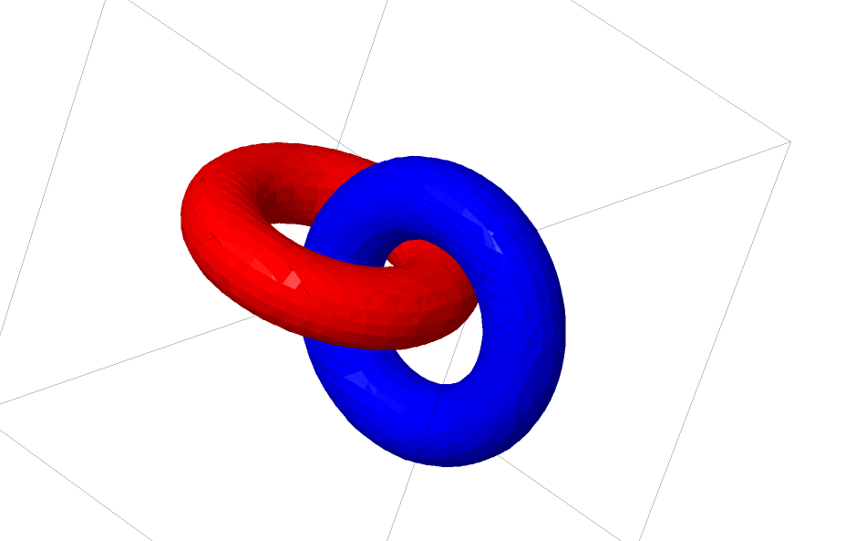
1. Why Increase Depth
Links And Homotopy
Notes:
Homotopy 동형

Slide 18
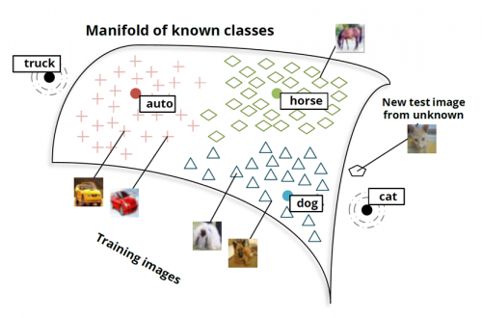
1. Why Increase Depth
Manifold Hypothesis
Notes:
Homotopy 동형

Slide 19
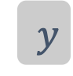

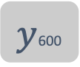



2. Stacked LSTM Architecture
Stacked-LSTM
(1,32)
(1,8)
$y$600
$$y$$
Dense Layer
(2)
Next time-step의 값
(1,64)
(1)
(1,128)
(1,64)
(1,8)
(1) : return_sequences=True로
모든 시점에 대한 은닉상태 출력
(2) : return_sequences=False로
마지막 하나의 은닉 상태만 출력
(1,8)
$x$2
$x$3
$x$600
$x$1

Slide 20
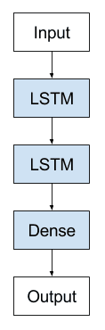
2. Stacked LSTM Architecture

Slide 21
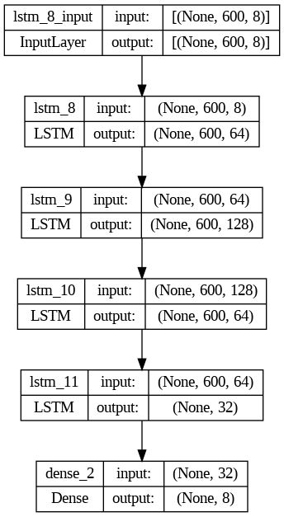
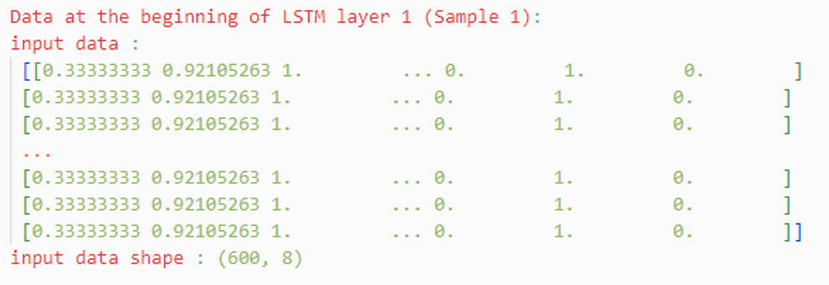
2. Stacked LSTM Architecture

Slide 22
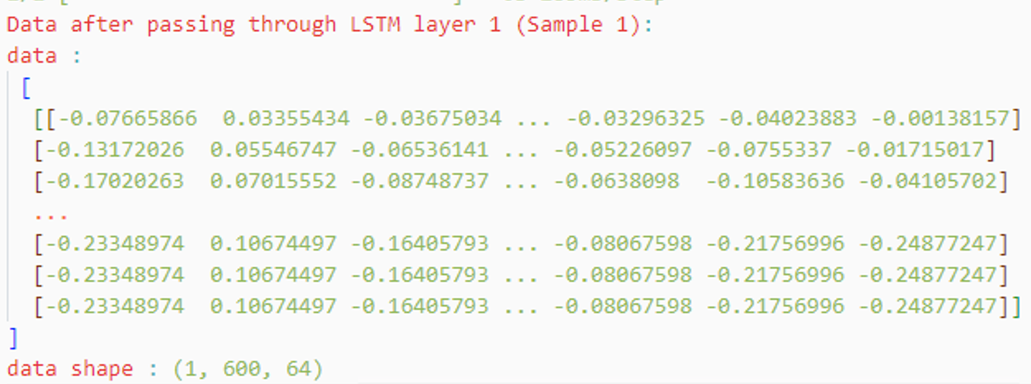
2. Stacked LSTM Architecture

Slide 23
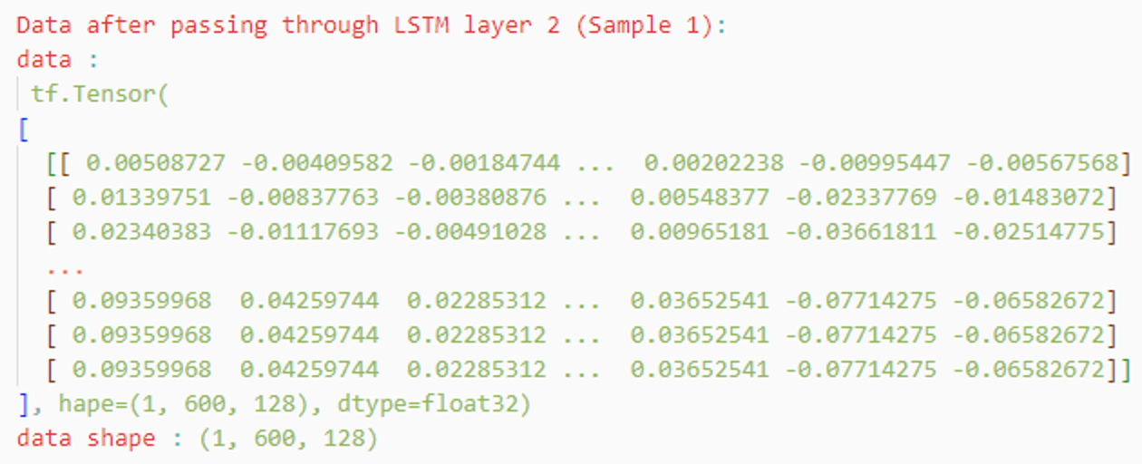
2. Stacked LSTM Architecture

Slide 24
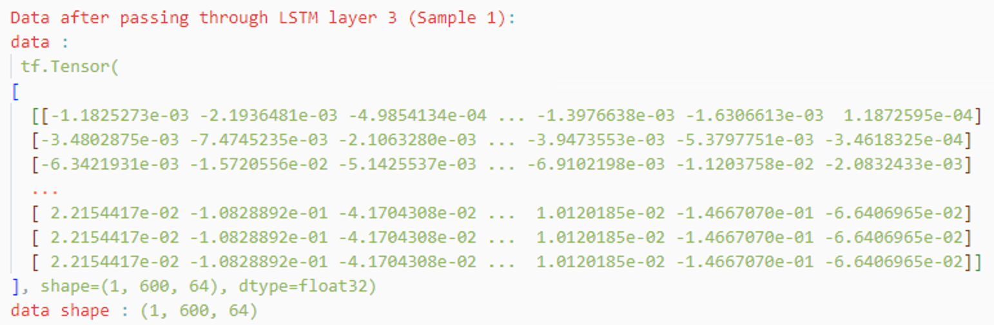
2. Stacked LSTM Architecture

Slide 25
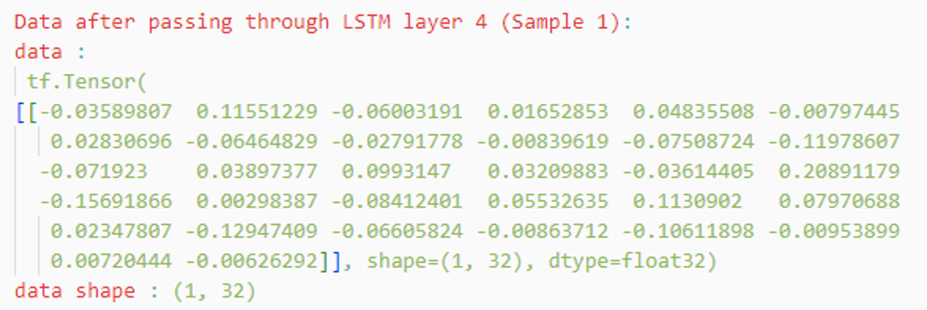
2. Stacked LSTM Architecture

Slide 26
2. Stacked LSTM Architecture

Slide 27
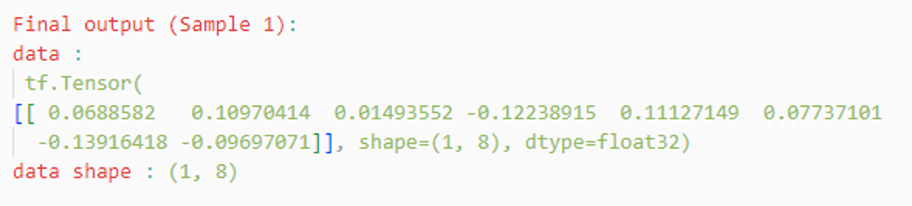
2. Stacked LSTM Architecture

Slide 28
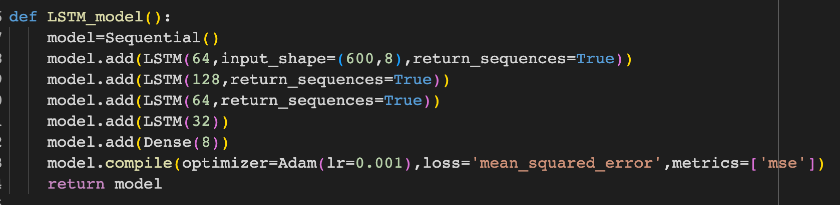
3. Stacked LSTMs in Keras

Slide 29



Thankyou

